Slide 1
A new way of taking
Attendance at large events
Using data mining & sentiment analysis
Harris Schrick

Slide 2

Overall Goal of Project
I want to solve a practical real world problem with a new and unique solution using technology I have never used before.

Slide 3
Overview
Learn Python/Tweepy
Stages of progress throughout semester
Demonstration
Tools used
Design
Style
Struggles
Future additions

Slide 4
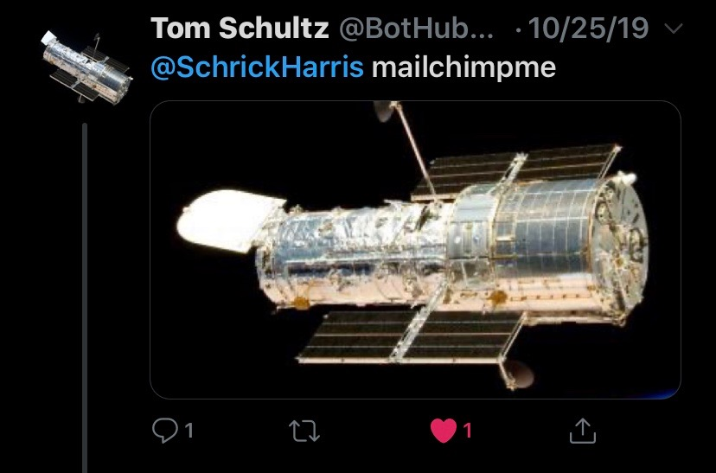


Learning Python and Tweepy

Slide 5
Brainstorming stage
Everything I came up with before the first presentation
1

Slide 6
Rough draft senior project
Harris Schrick

Slide 7
Recognized Problem
In the professional world companies, schools, churches, and communities alike put on events outside of regular hours/schedules that they offer employee’s to attend.
These events range from things like company softball, company 5k run for charity, concerts, professional talks, parades and so on.
The problem with events such as these are that being able to see who attended them or figuring out how to prove you attended them can be a daunting task.
Large crowds, weather conditions, open outdoor spaces, constant movement etc. can all cause check in area’s/taking attendance a major problem.

Slide 8
Solution – SelfieHere(this name will probably change)
SelfieHere makes proving attendance at events simple.
Simply pull out your phone, take a picture of yourself with the event in the background, and post it on twitter with the hashtag #selfiehere+[event name] and also your name. (your company will give you the event name)

Slide 9
How it works
You post your event selfie with the hashtag
Our program (Desktop app, website, phone app maybe). Will crawl through twitter for your selected hashtag, separate the name, picture, and timestamp of each post in a selected time period,(optional) collects location, and display it alongside your coworkers as if it were a roll call sheet.

Slide 10
Base functionality
Heavy use of twitter api.
Will connect a searched event with #selfiehere and crawl through that hashtag
Collecting/scraping data from tweets.
Organization of data in clean format.
Option to clear data after event is accounted for.
Able to collect single selfies and group selfies with multiple names.

Slide 11
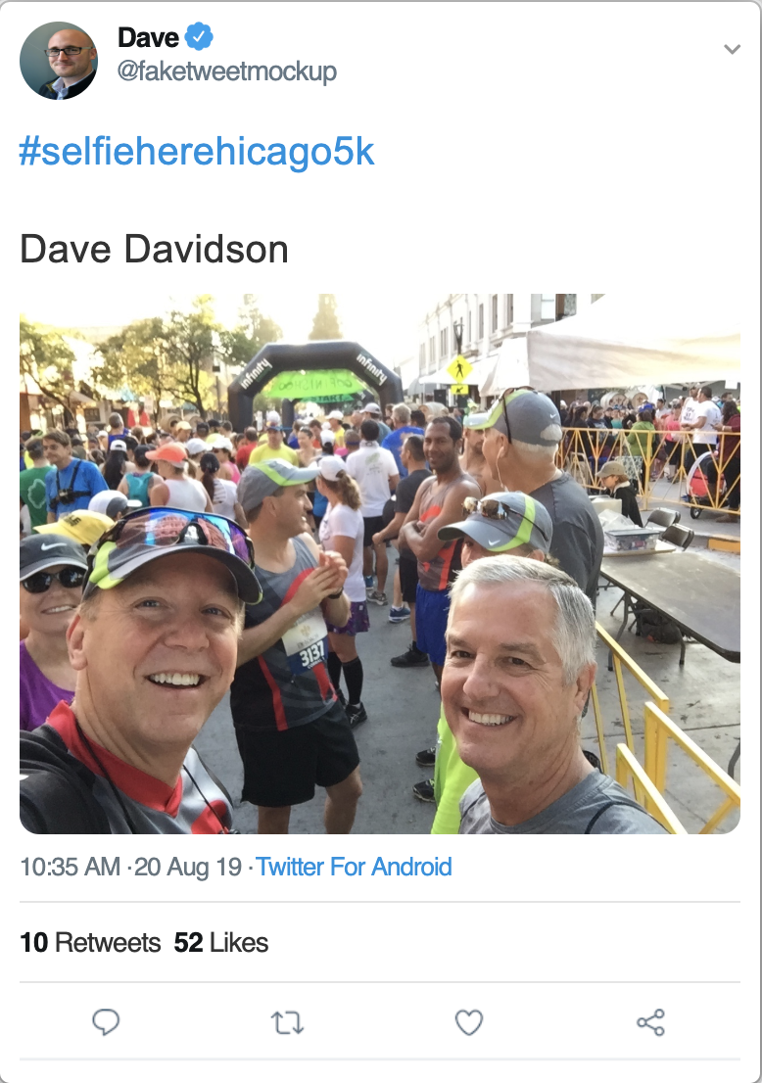
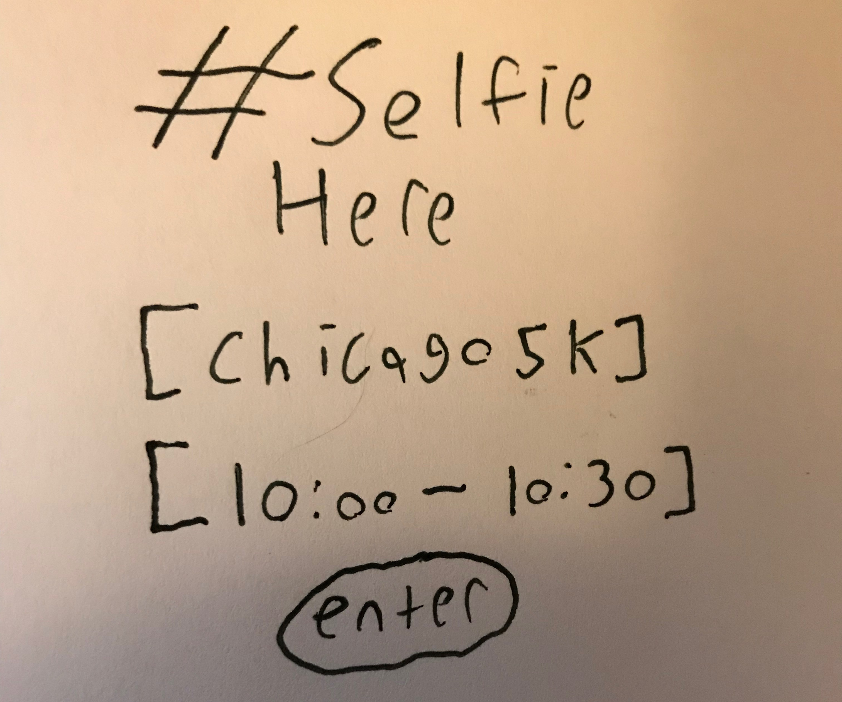
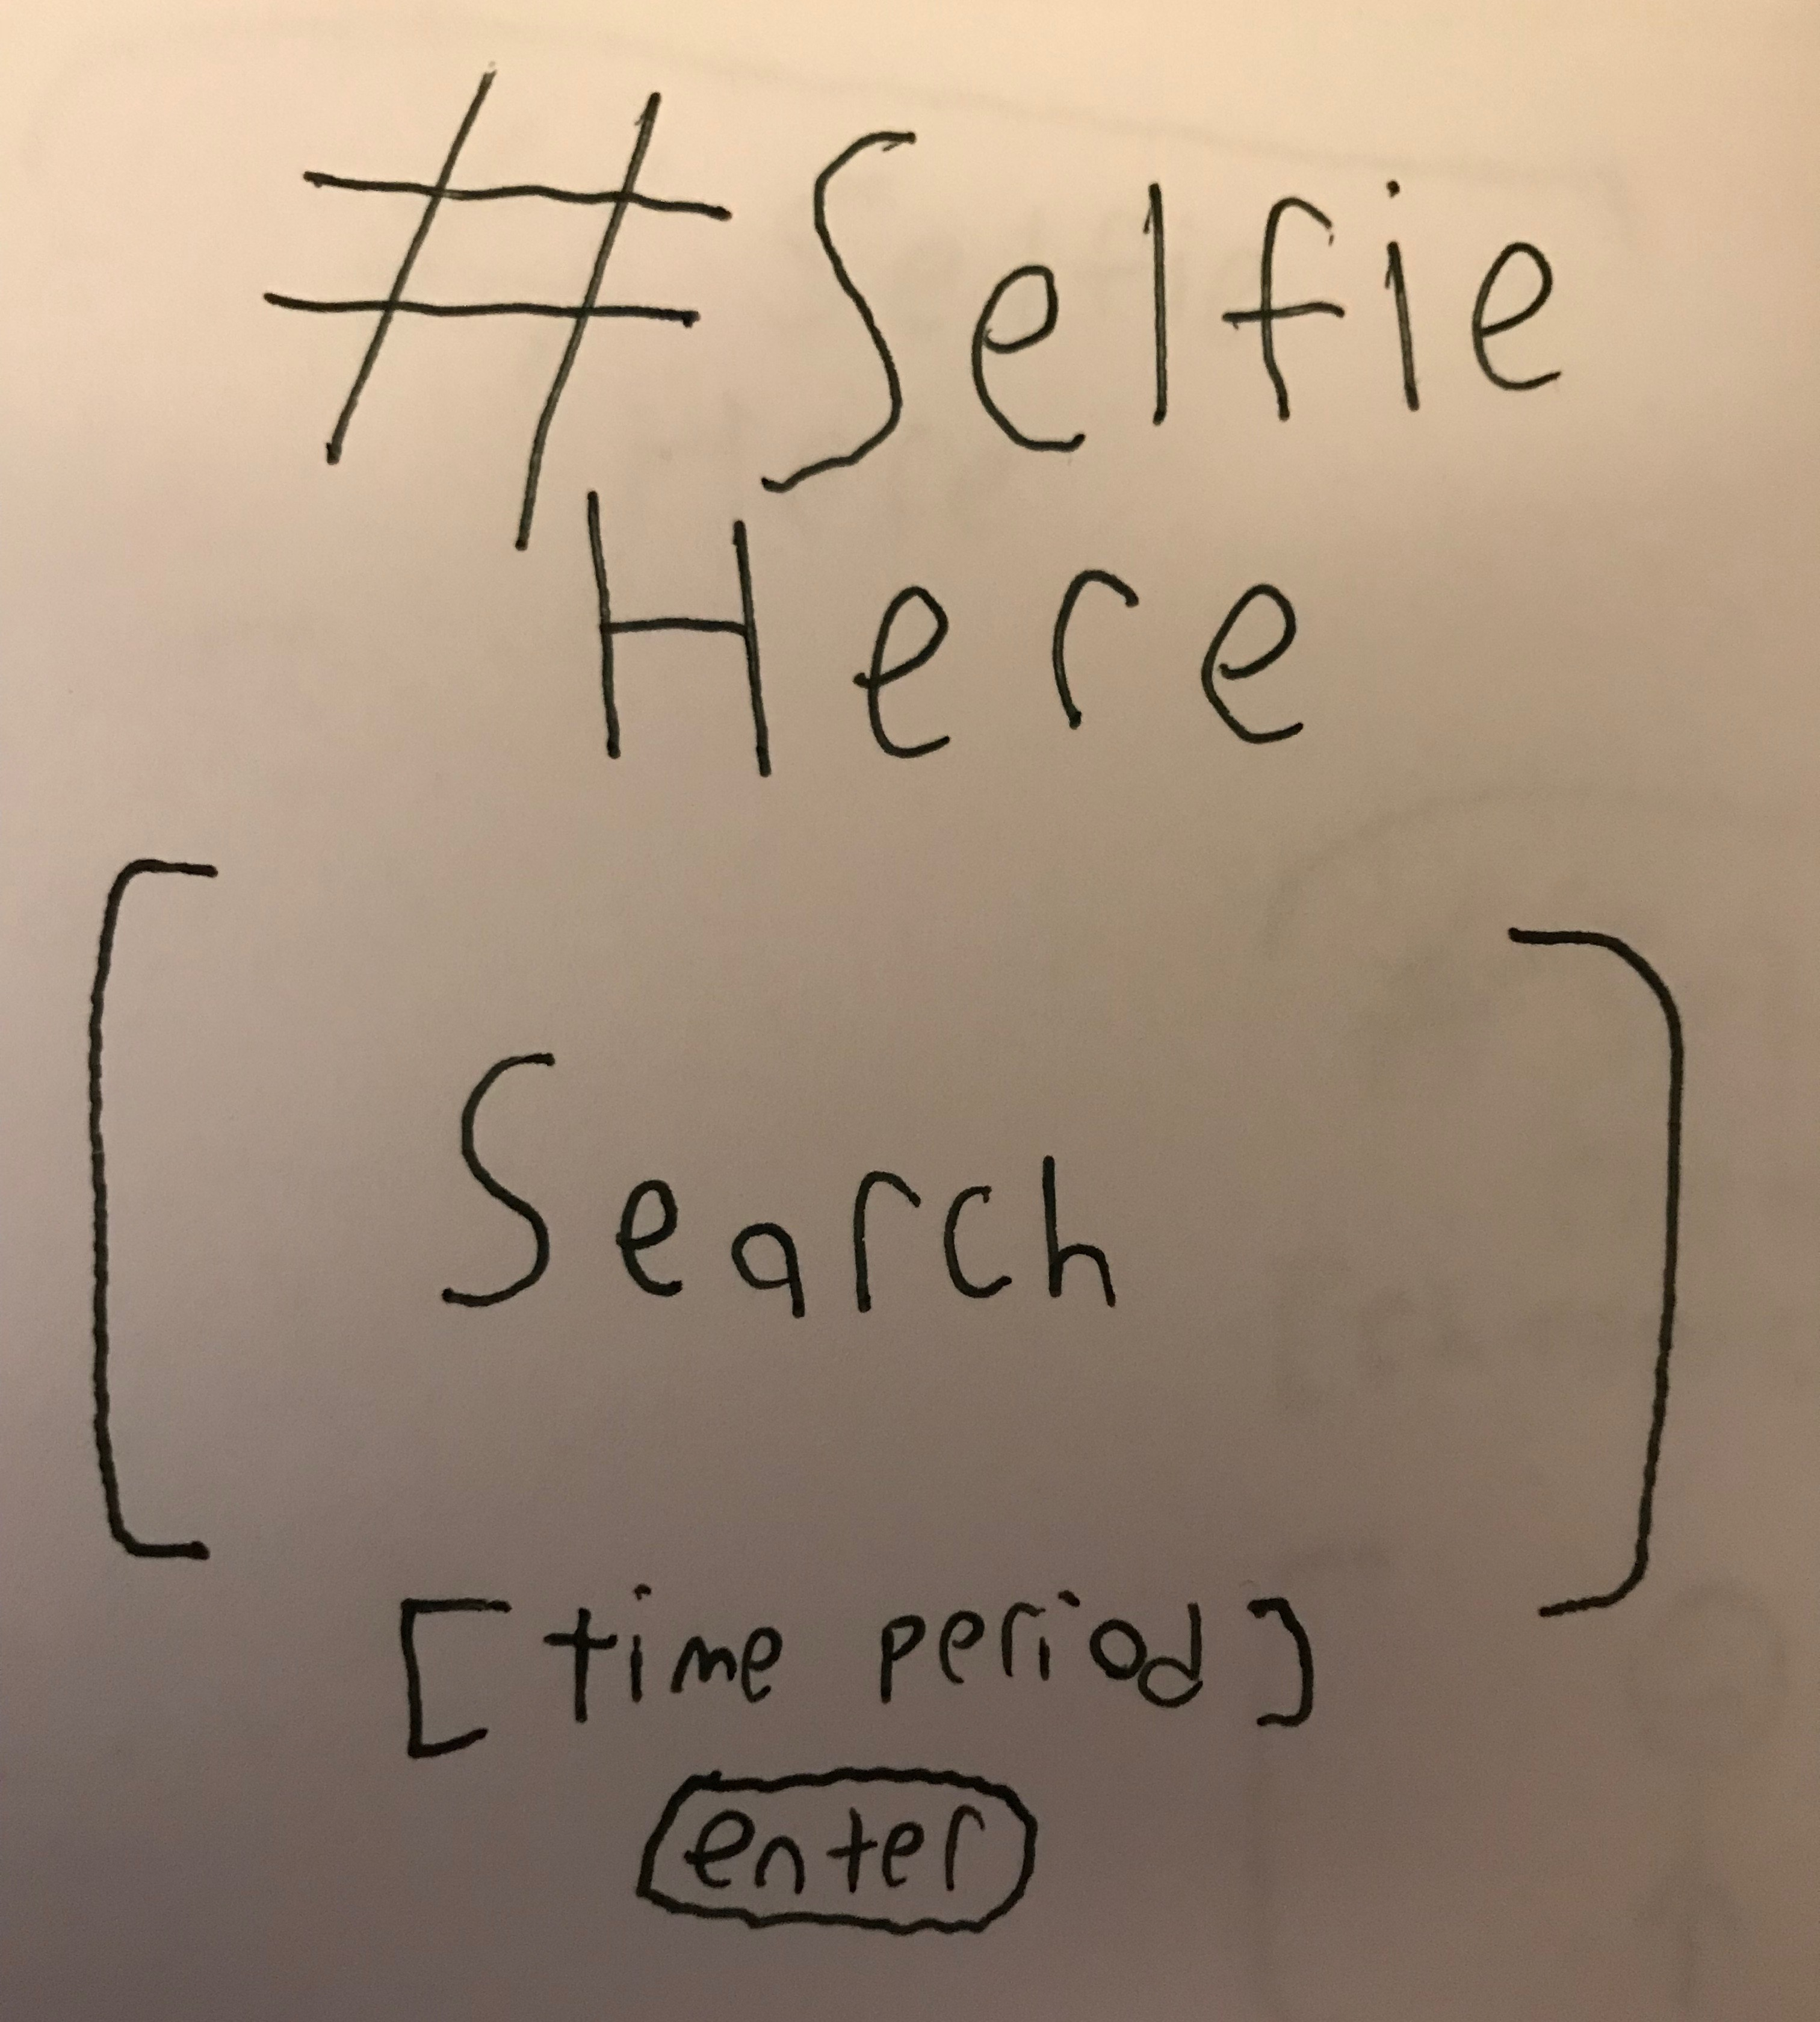
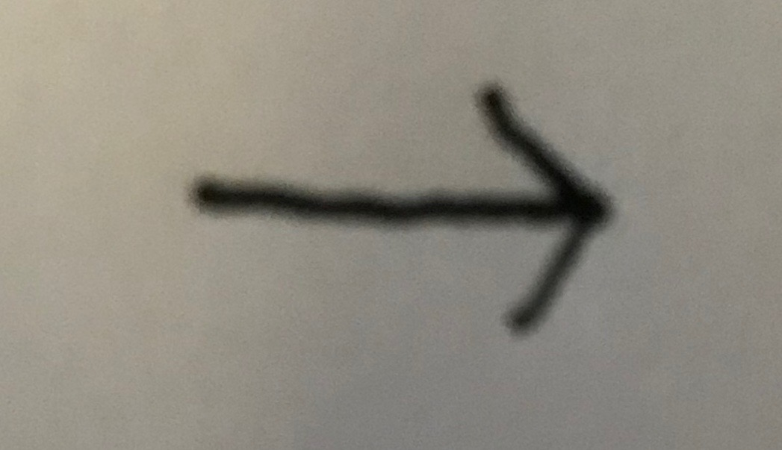
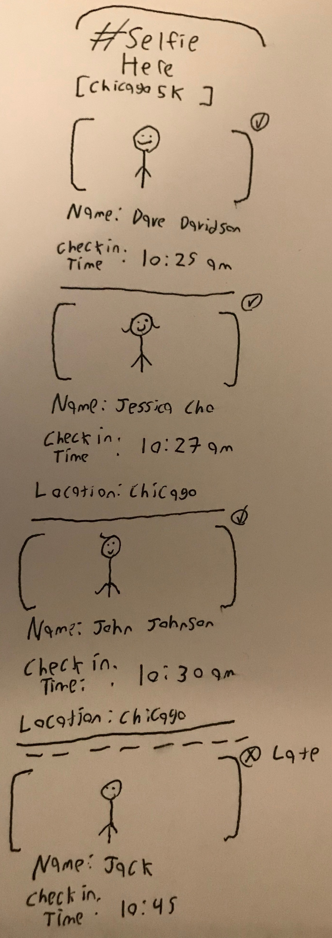
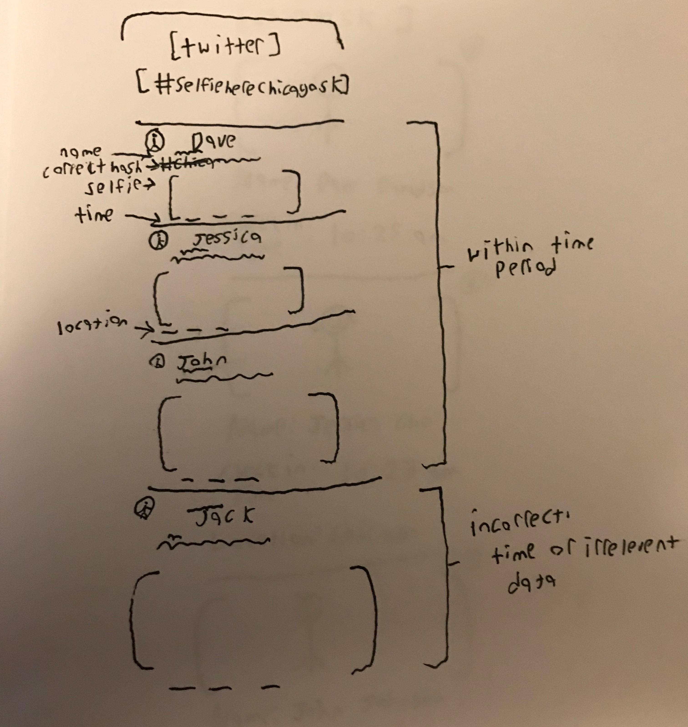
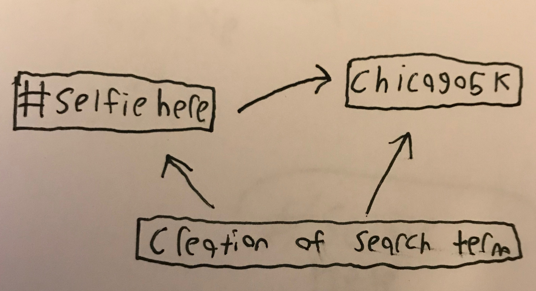
Base
Functionality

Slide 12
Presentation 1 stage
A more precise understanding and basic progress
2

Slide 13
Intentions
Work
School
Out of office meetings
Charity 5k’s/races
Lunch meetups
Corporate Talks
Work Softball/Sports team meetups
Large outdoor gatherings
Field trips
Museum Visits
Sports
Volunteering
Plays
Educational Speeches/performances
Other External assignments

Slide 14
The Solution
Step 2
Upload to twitter with given tag and
Comment on event
Step 1
Step 3
Superior simply types in given tag and timespan of event on selfiehere program
Take a selfie with the event in the background

Slide 15
Step 4
SelfieHere will then:
Grab users tweet data within specific time period.
Take attendance down to the minute and second of tweet.
Verify a photo was taken
Compile attendee’s separate comments and perform a sentiment analysis about the event.
Display the top 3 most popular comments about the event.

Slide 16
Base Functionality
Time constrained
data gathering
Ability to take attendance
Disregards irrelevant tweets
Custom Simple Sentiment
Analyzer
Custom Data Dump
Clean UI

Slide 17
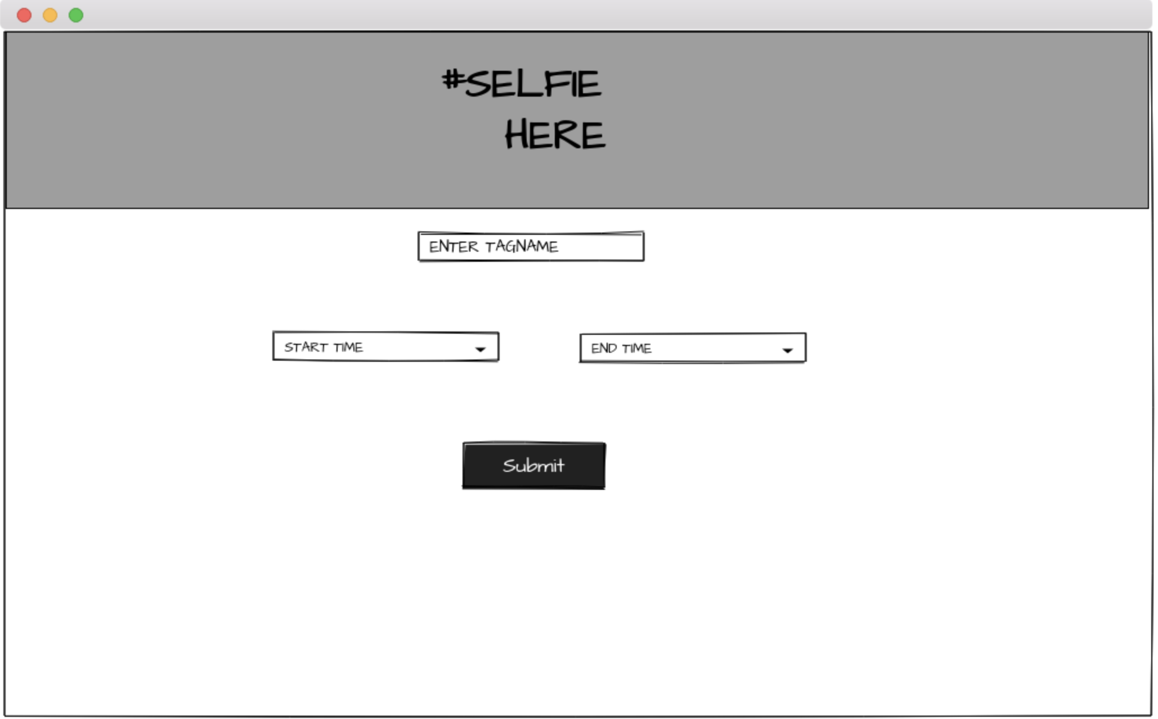
Mockups – page 1

Slide 18
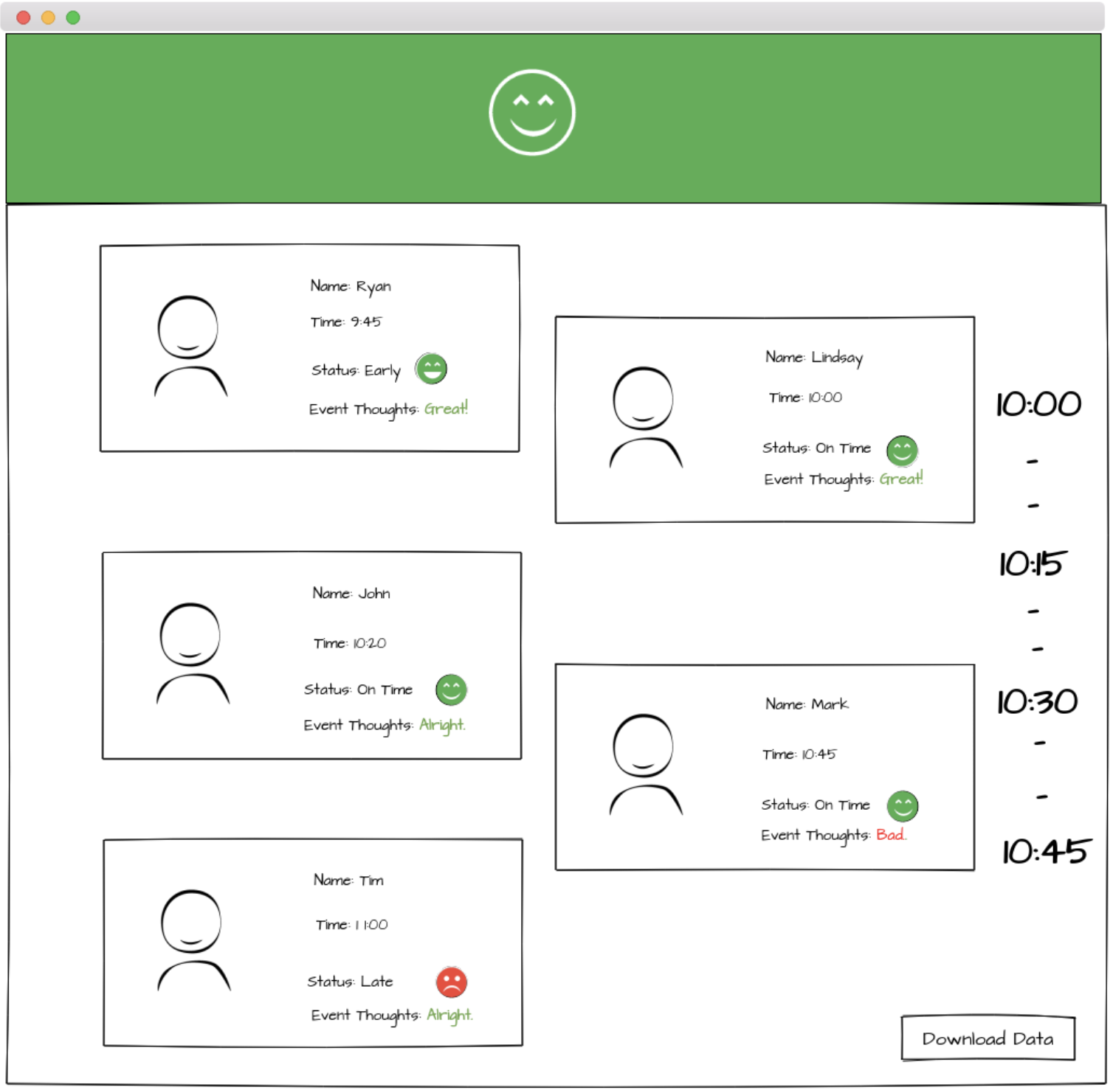
Mockups – page 2

Slide 19
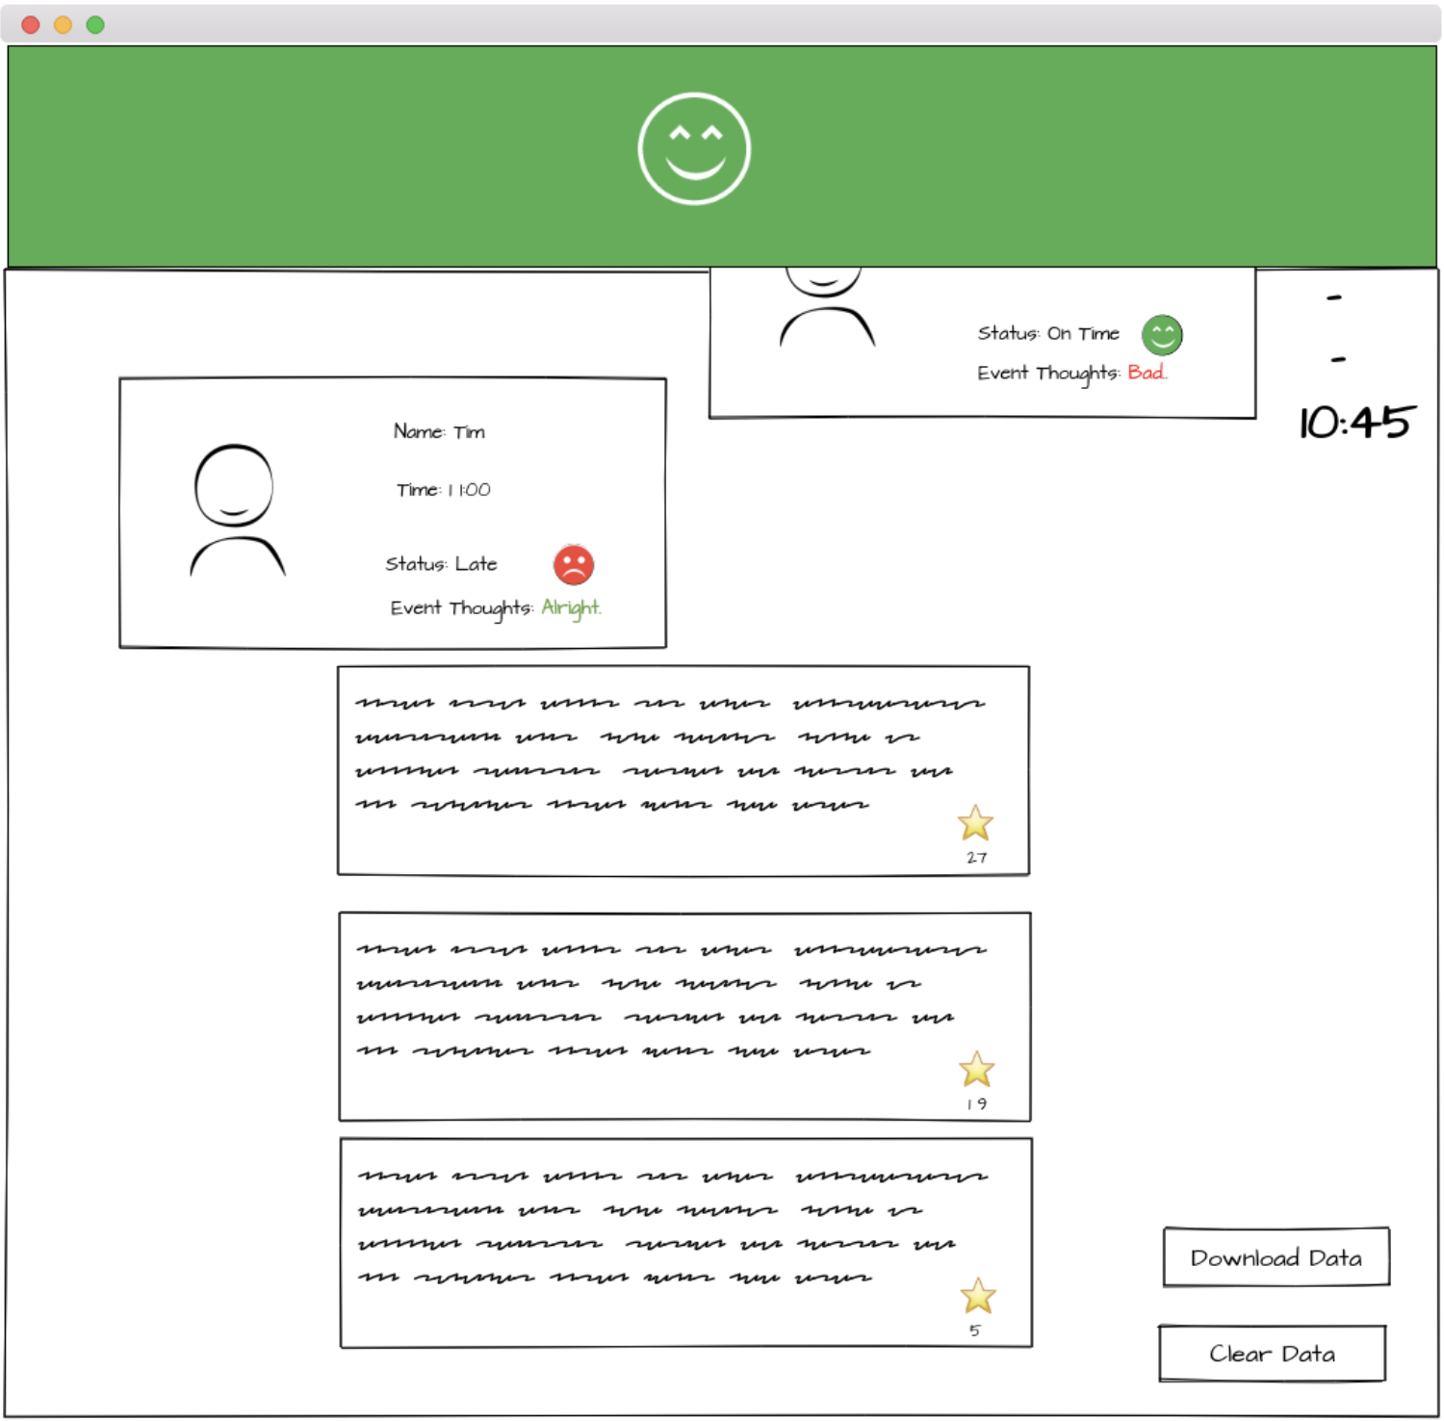
Mockups – page 3

Slide 20
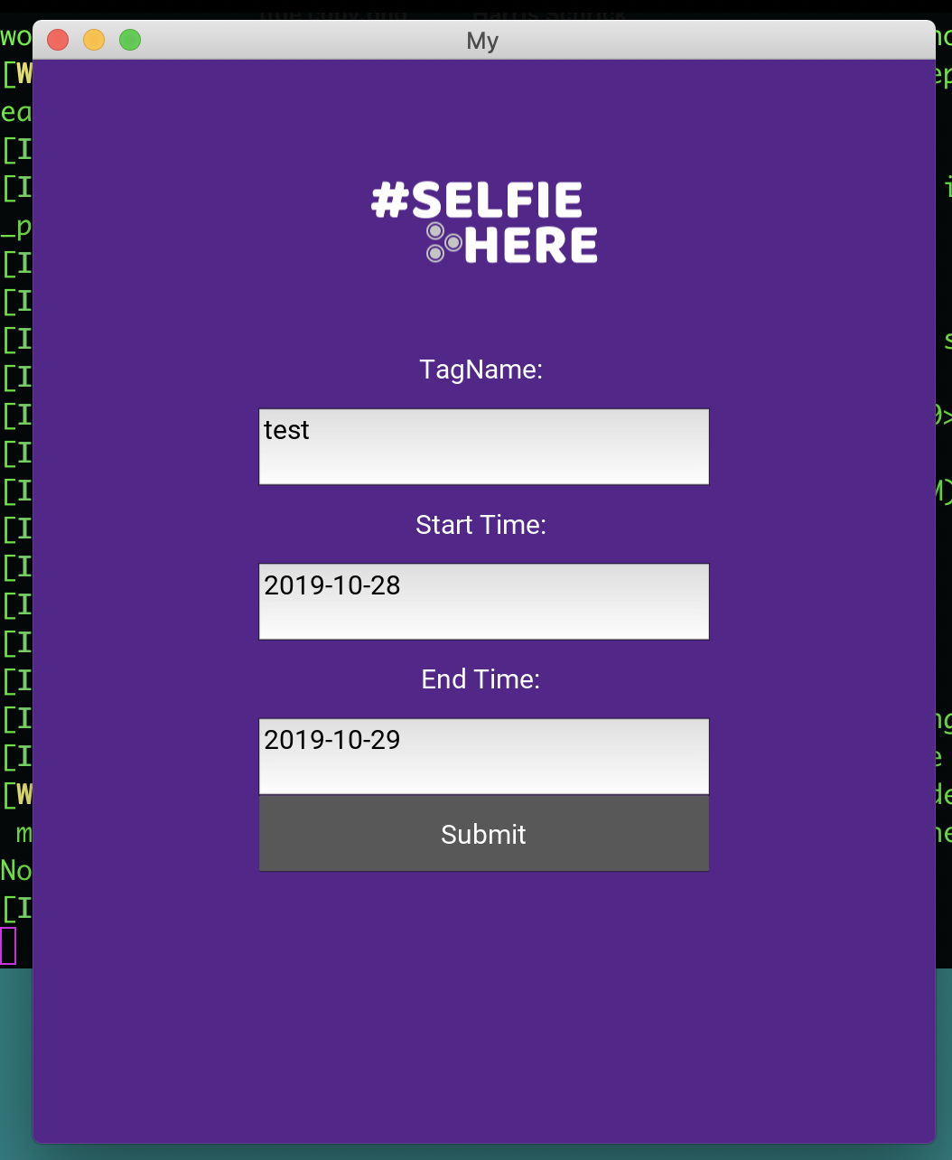
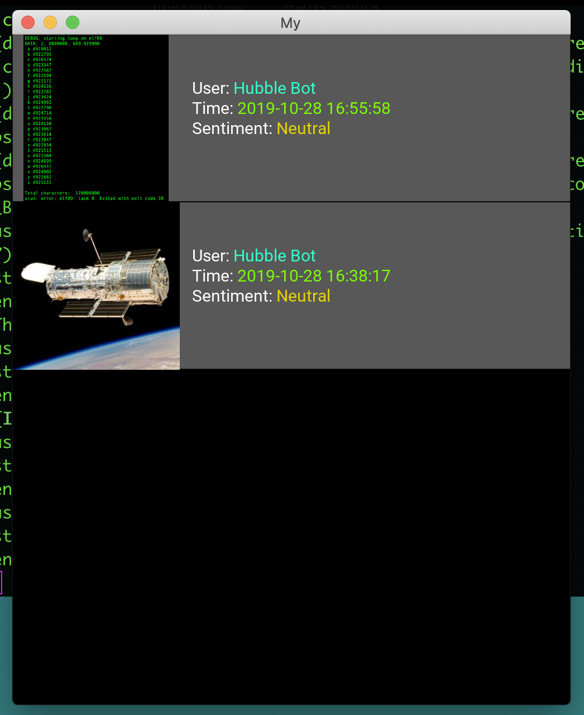
Presentation 2, first demonstration

Slide 21

Final Product

Slide 22
Features
Reactive custom programmically made ui.
Data collection between start time/End time of events .
Late time between the time started and the end time. Up to 24 hours.
User messages automatically analyzed and placed within 5 sentiment categories: Great, Good, Neutral, Bad, Awful.
Time reformatting.
Takes the top 3 most popular interacted with tweets, cleans and posts them anonymously.
Combines everyone's sentiment into an overall sentiment.

Slide 23
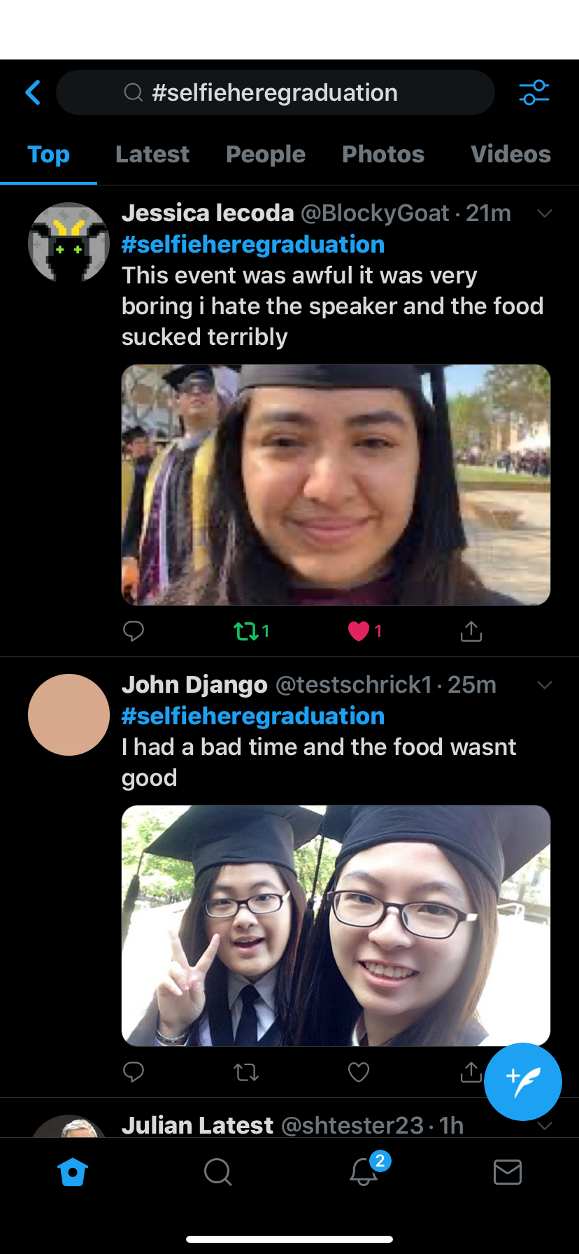
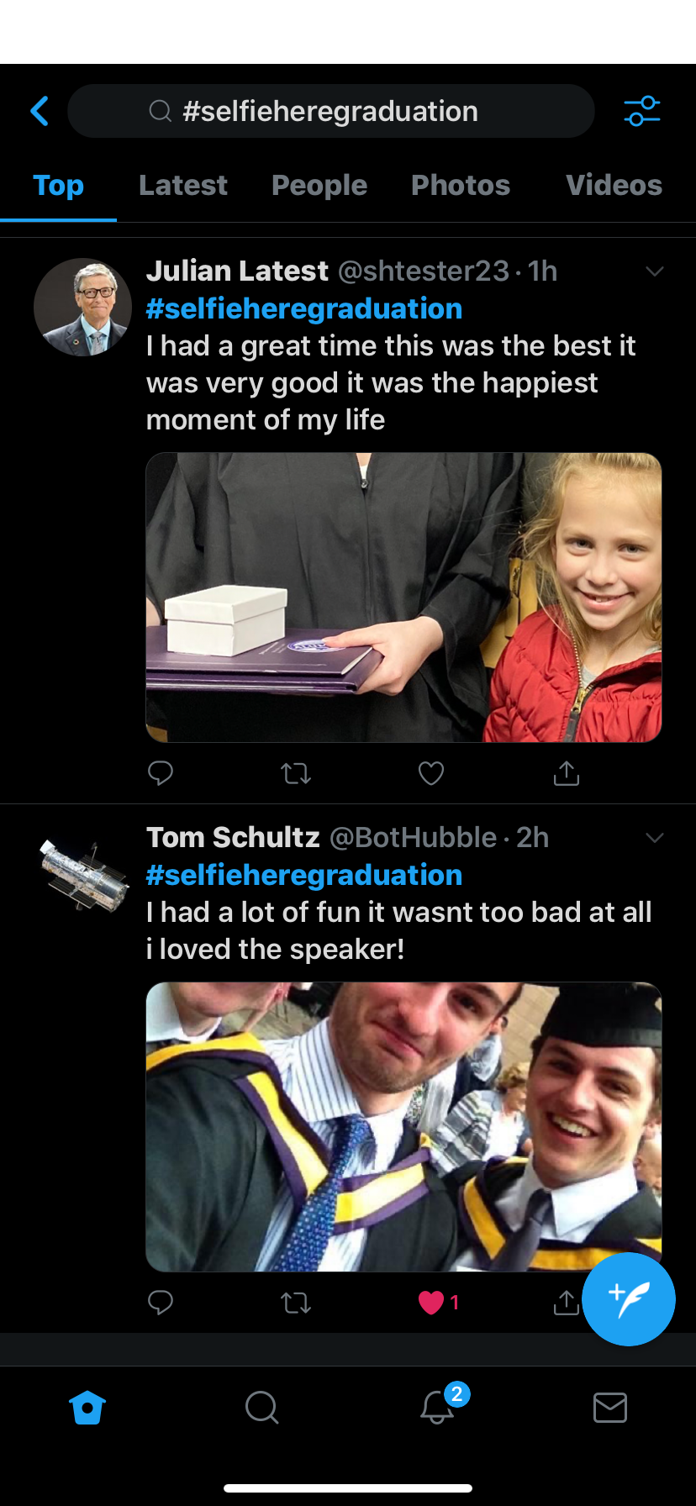
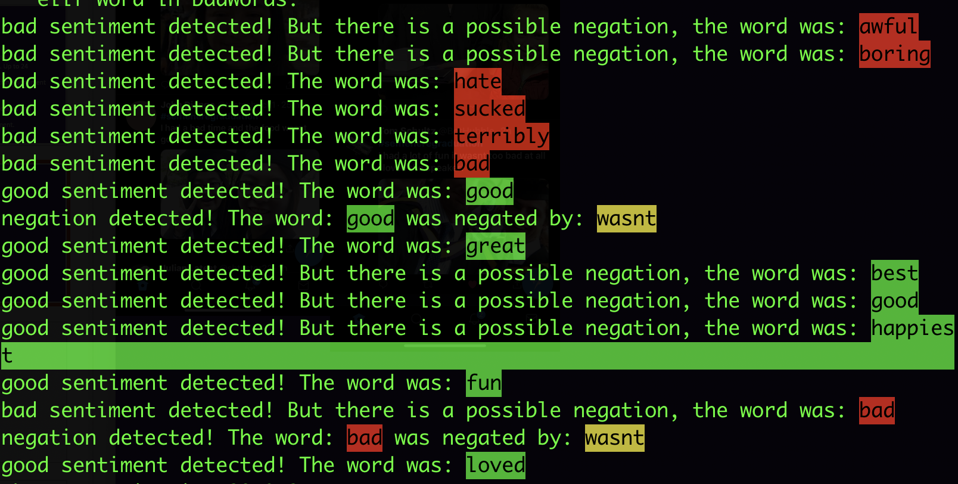
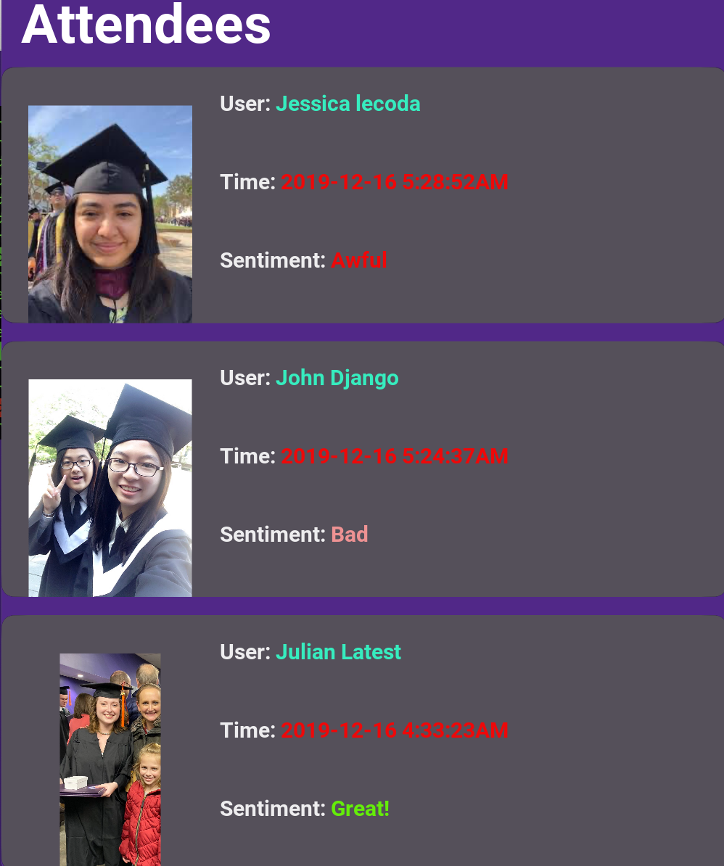
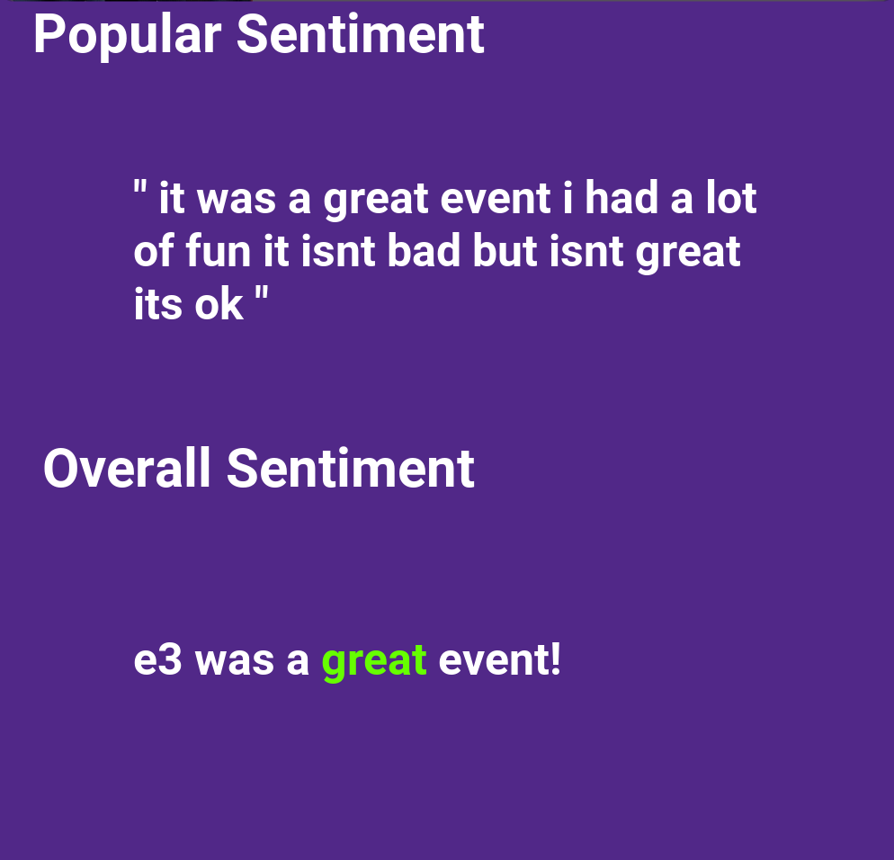

Slide 24


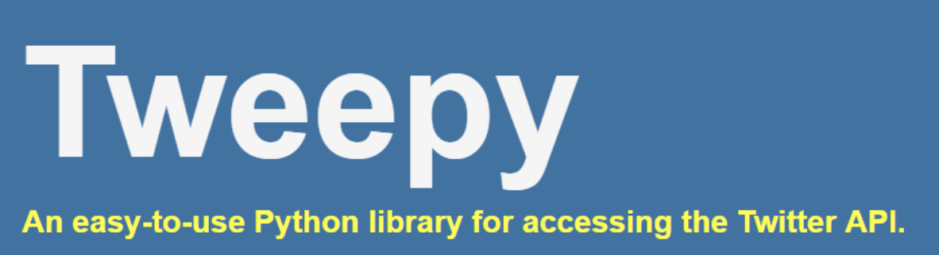
Tools Used

Slide 25
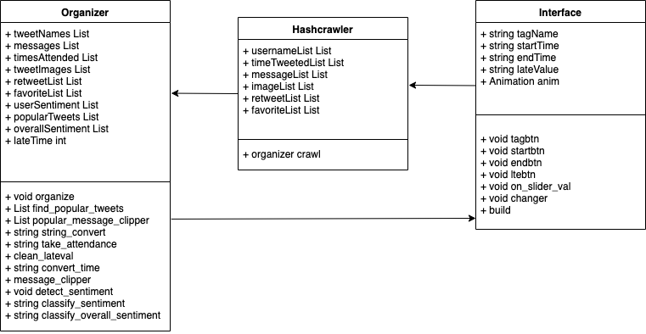
Design

Slide 26
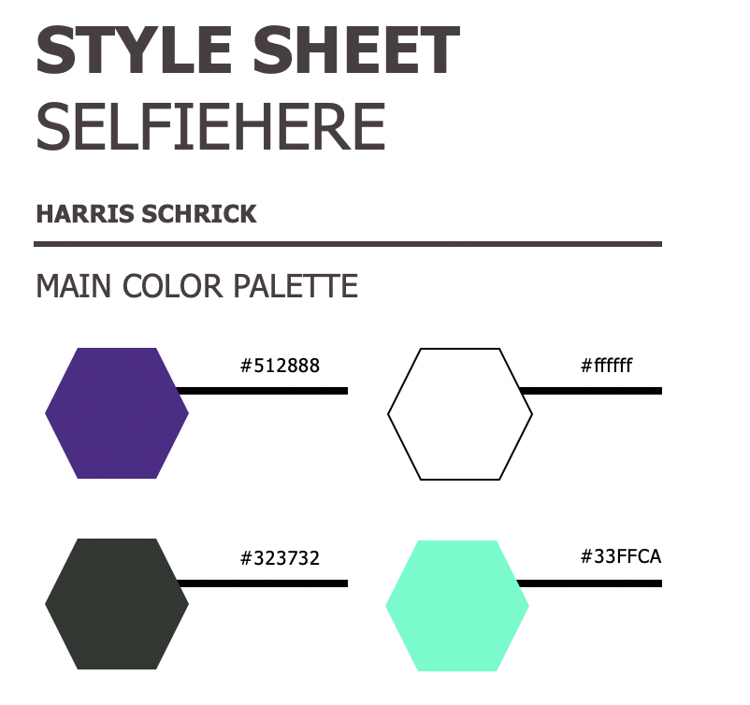
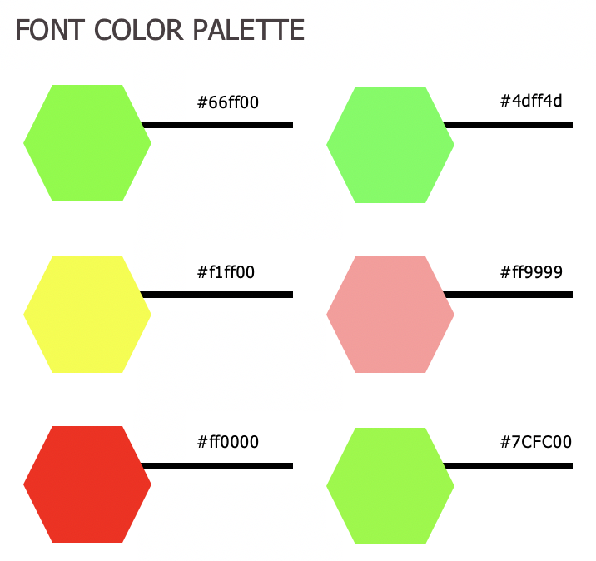
Style

Slide 27
Struggles
Programmically building the ui was incredibly difficult
Processing twitters data came with many bugs
Interacting with queried data is semi unreliable

Slide 28
Future Additions
Translate to php to make it accessible online
Build a user side and skip twitter all together
Implement facial detection to further filter posts
Build API to allow schools/work to customize auto attendance takers/whatever they want.
Allow a variety of methods to take attendance such as: unique event codes at events, QR codes, message keys, geolocation.

Slide 29
Questions?

